Slide 1
VAIDS-DSML exercise block 9
Jasmin Duvivié

Slide 2
simple linear regression
problem
1599 samples of wines
11 features
1 target: quality
1 feature as linear regressor: alcohol
solution
use sklearn.linear_model
construct model manually
compare ols parameters (slope and intercept)

Slide 3





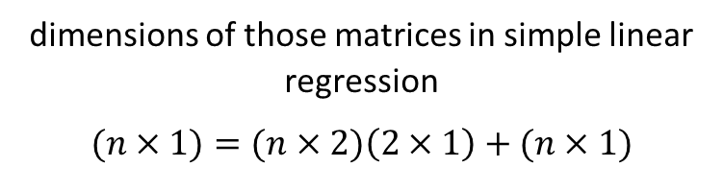
simple linear regression
coefficients
$$β= \left[\begin{matrix}β_{0} \\ β_{1}\end{matrix}\right]$$
function for linear regression
$$y_{i}=β_{0}+β_{i}x_{i}+ε_{1}$$
as matrices
$$y=xβ+ε$$
estimate for $β$
$$b=\left[\begin{matrix}b_{0} \\ b_{1}\end{matrix}\right]$$
dimensions of those matrices in simple linear regression
$$(n×1)=(n×2)\left(2×1\right)+(n×1)$$
prediction $\hat{y}$
$$\hat{y}=xb$$

Slide 4





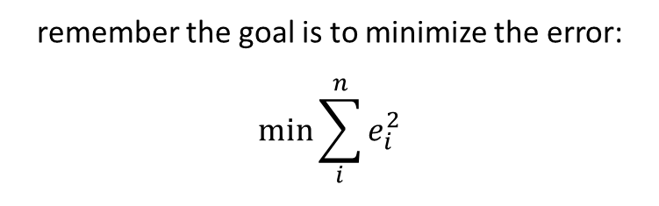

simple linear regression
remember the goal is to minimize the error:
$$\min{\sum_{i}^{n}{e_{i}^{2}}}$$
error $e$
$$e=y−\hat{y}$$
or
$$e=y−xb$$
or
$$\min{e^{T}}e$$
or
$$\min{{(y−xb)}^{T}}(y−xb)$$
note dimensions
$$\left(n×1\right)=\left(n×1\right)−(n×1)$$
note dimensions
$$\left(1×n\right)\left(n×1\right)=(1×1)$$

Slide 5
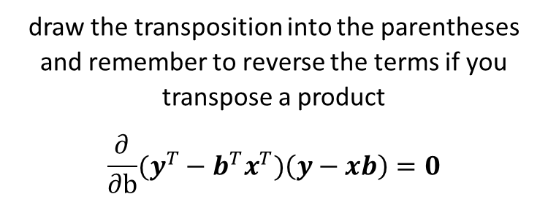
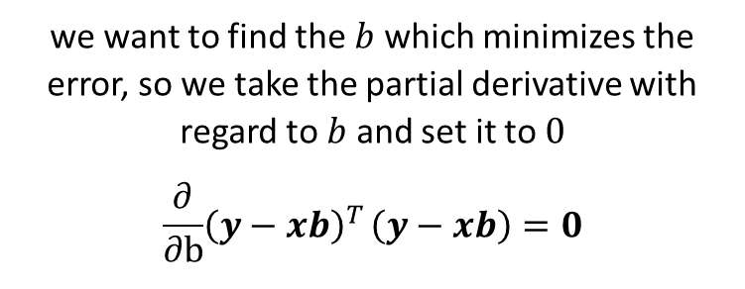
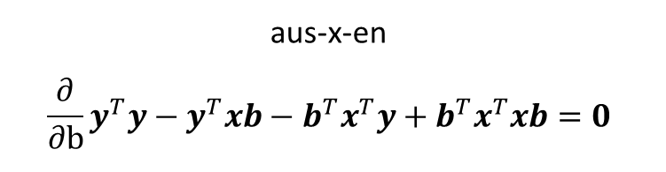
simple linear regression
we want to find the $b$ which minimizes the error, so we take the partial derivative with regard to $b$ and set it to $0$
$$\frac{∂}{∂b}{{\left(y−xb\right)}^{T}}\left(y−xb\right)=0$$
draw the transposition into the parentheses and remember to reverse the terms if you transpose a product
$$\frac{∂}{∂b}{(y^{T}}−b^{T}x^{T})\left(y−xb\right)=0$$
aus-x-en
$${\frac{∂}{∂b}y}^{T}y−y^{T}xb−b^{T}x^{T}y+b^{T}x^{T}xb=0$$

Slide 6
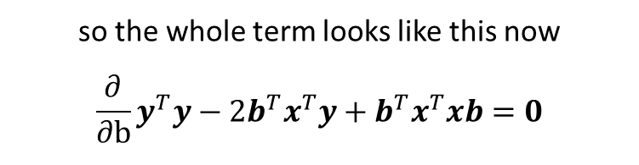
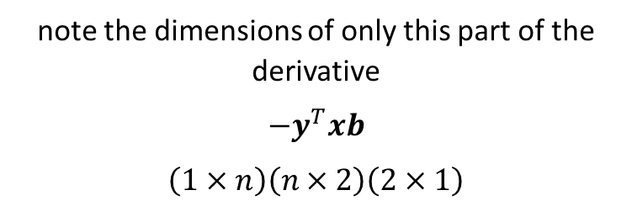
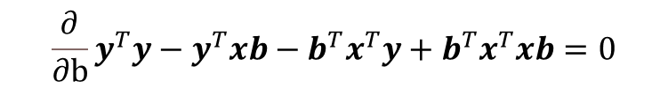
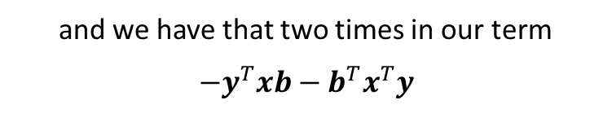

simple linear regression manually
$${\frac{∂}{∂b}y}^{T}y−y^{T}xb−b^{T}x^{T}y+b^{T}x^{T}xb=0$$
note the dimensions of only this part of the derivative
$$−y^{T}xb$$
$$\left(1×n\right)\left(n×2\right)\left(2×1\right)$$
and we have that two times in our term
$$−y^{T}xb−b^{T}x^{T}y$$
$$−2b^{T}x^{T}y$$
$$\left(1×n\right)\left(n×1\right)$$
so the whole term looks like this now
$${\frac{∂}{∂b}y}^{T}y−2b^{T}x^{T}y+b^{T}x^{T}xb=0$$
$$\left(1×1\right)$$
so it is a scalar

Slide 7
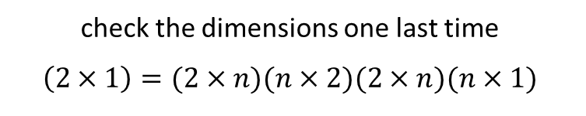
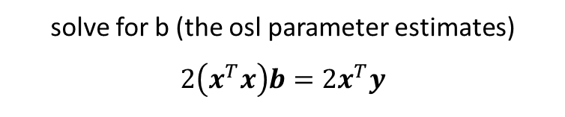

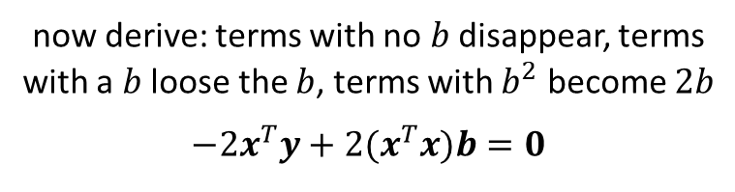


simple linear regression
now derive: terms with no $b$ disappear, terms with a $b$ loose the $b$, terms with $b^{2}$ become $2b$
$$−2x^{T}y+2(x^{T}x)b=0$$
$$b={\left(x^{T}x\right)}^{−1}\left(x^{T}y\right)$$
check the dimensions one last time
$$\left(2×1\right)=(2×n)(n×2)(2×n)(n×1)$$
solve for b (the osl parameter estimates)
$$2\left(x^{T}x\right)b=2x^{T}y$$
$$\left(2×1\right)=\left(2×2\right)\left(2×1\right)$$
$$\left(x^{T}x\right)b=x^{T}y$$
same as
$$\hat{y}=xb$$
$${\left(x^{T}x\right)}^{−1}\left(x^{T}x\right)b={\left(x^{T}x\right)}^{−1}\left(x^{T}y\right)$$
$${\left(x^{T}x\right)}^{−1}\left(x^{T}x\right)=1$$
yay, checks out :)

